Slide 1
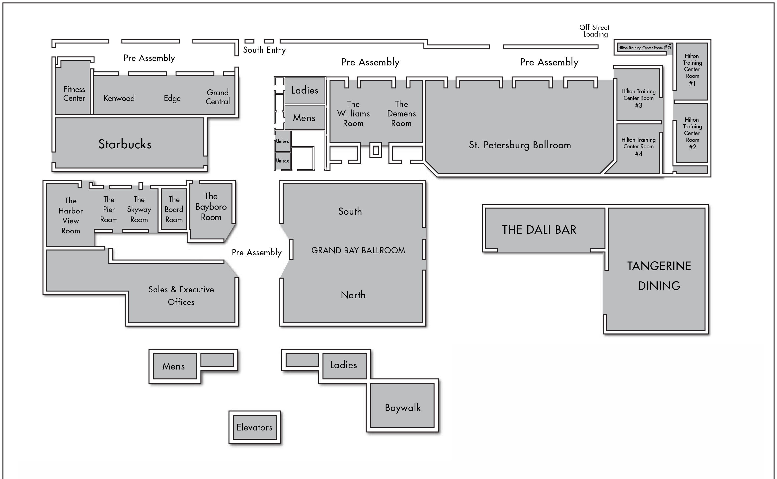
Main Exit
Emergency Exits
Emergency Exits
Main Entrance
Side Entrance/Exit to Parking Lot

